Slide 1



Write date here
Tours &
Travels

Slide 2
Our Management Team

Slide 3
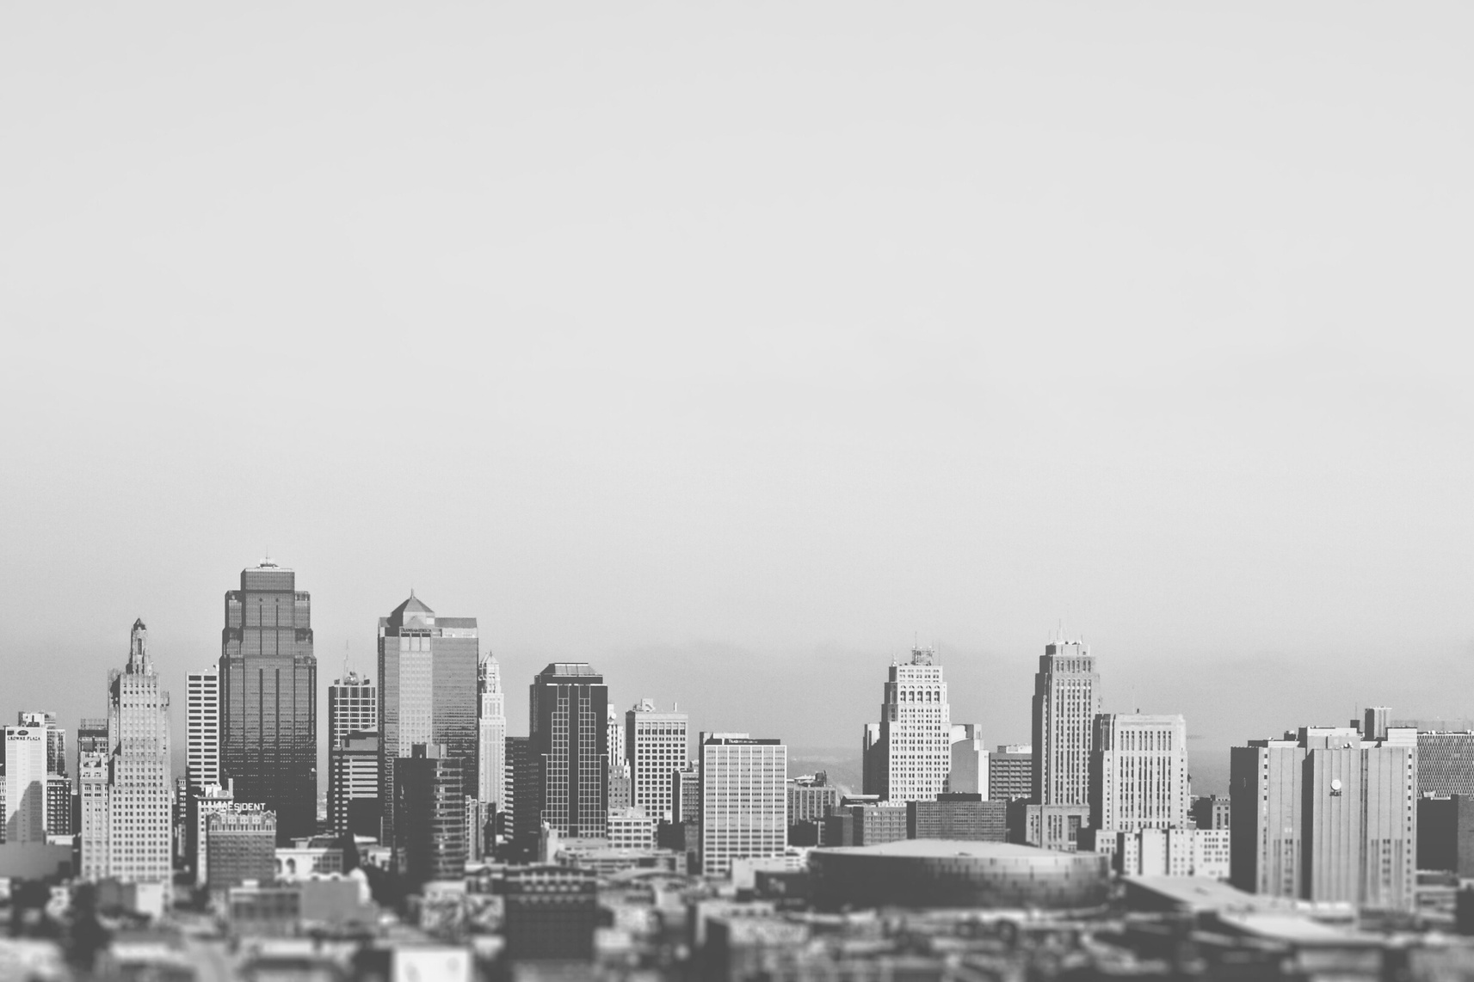
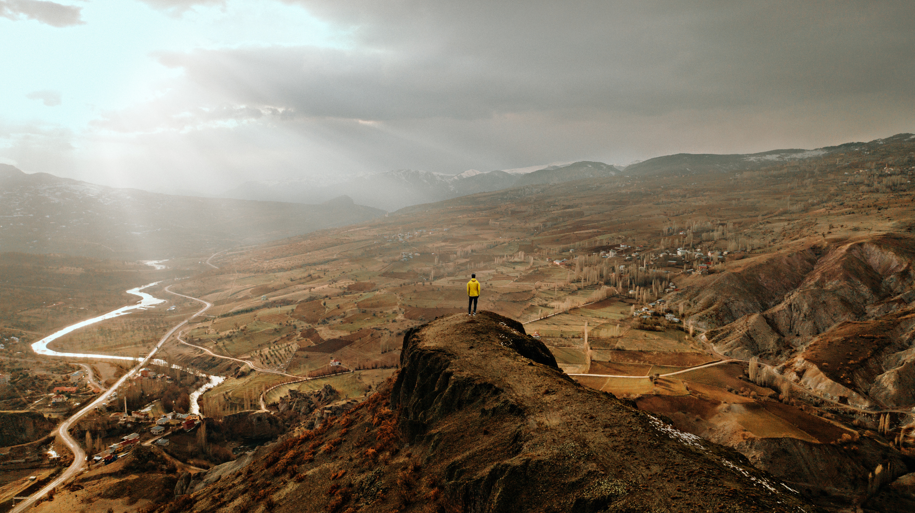
Welcome to the World of Tours and Travels
Traveling is one of life's greatest pleasures. It allows us to explore new horizons, meet new people, and experience different cultures. Whether you're a seasoned traveler or just starting out, there's always something new to discover.
The world is full of amazing destinations, each with its own unique charm and allure. From the bustling streets of Tokyo to the romantic boulevards of Paris, there's a destination for every type of traveler. So pack your bags and get ready for an adventure of a lifetime!

Slide 4
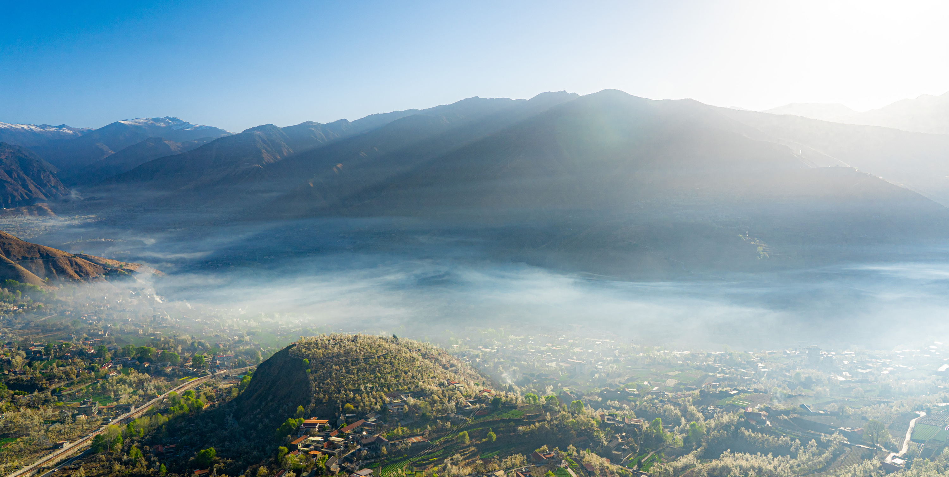
Popular Destinations
Paris, the city of love, is one of the most visited cities in the world. With its iconic Eiffel Tower, delicious cuisine, and rich history, it's easy to see why so many people flock to this romantic destination. Whether you're strolling along the Seine River or exploring the Louvre Museum, there's always something new to discover in Paris.
Tokyo, the bustling capital of Japan, is a vibrant metropolis that seamlessly blends old traditions with modern technology. From the neon lights of Shibuya to the serene gardens of Shinjuku Gyoen National Park, Tokyo offers a unique and exciting experience for travelers. Don't forget to try some of the delicious local cuisine, like sushi and ramen!

Slide 5
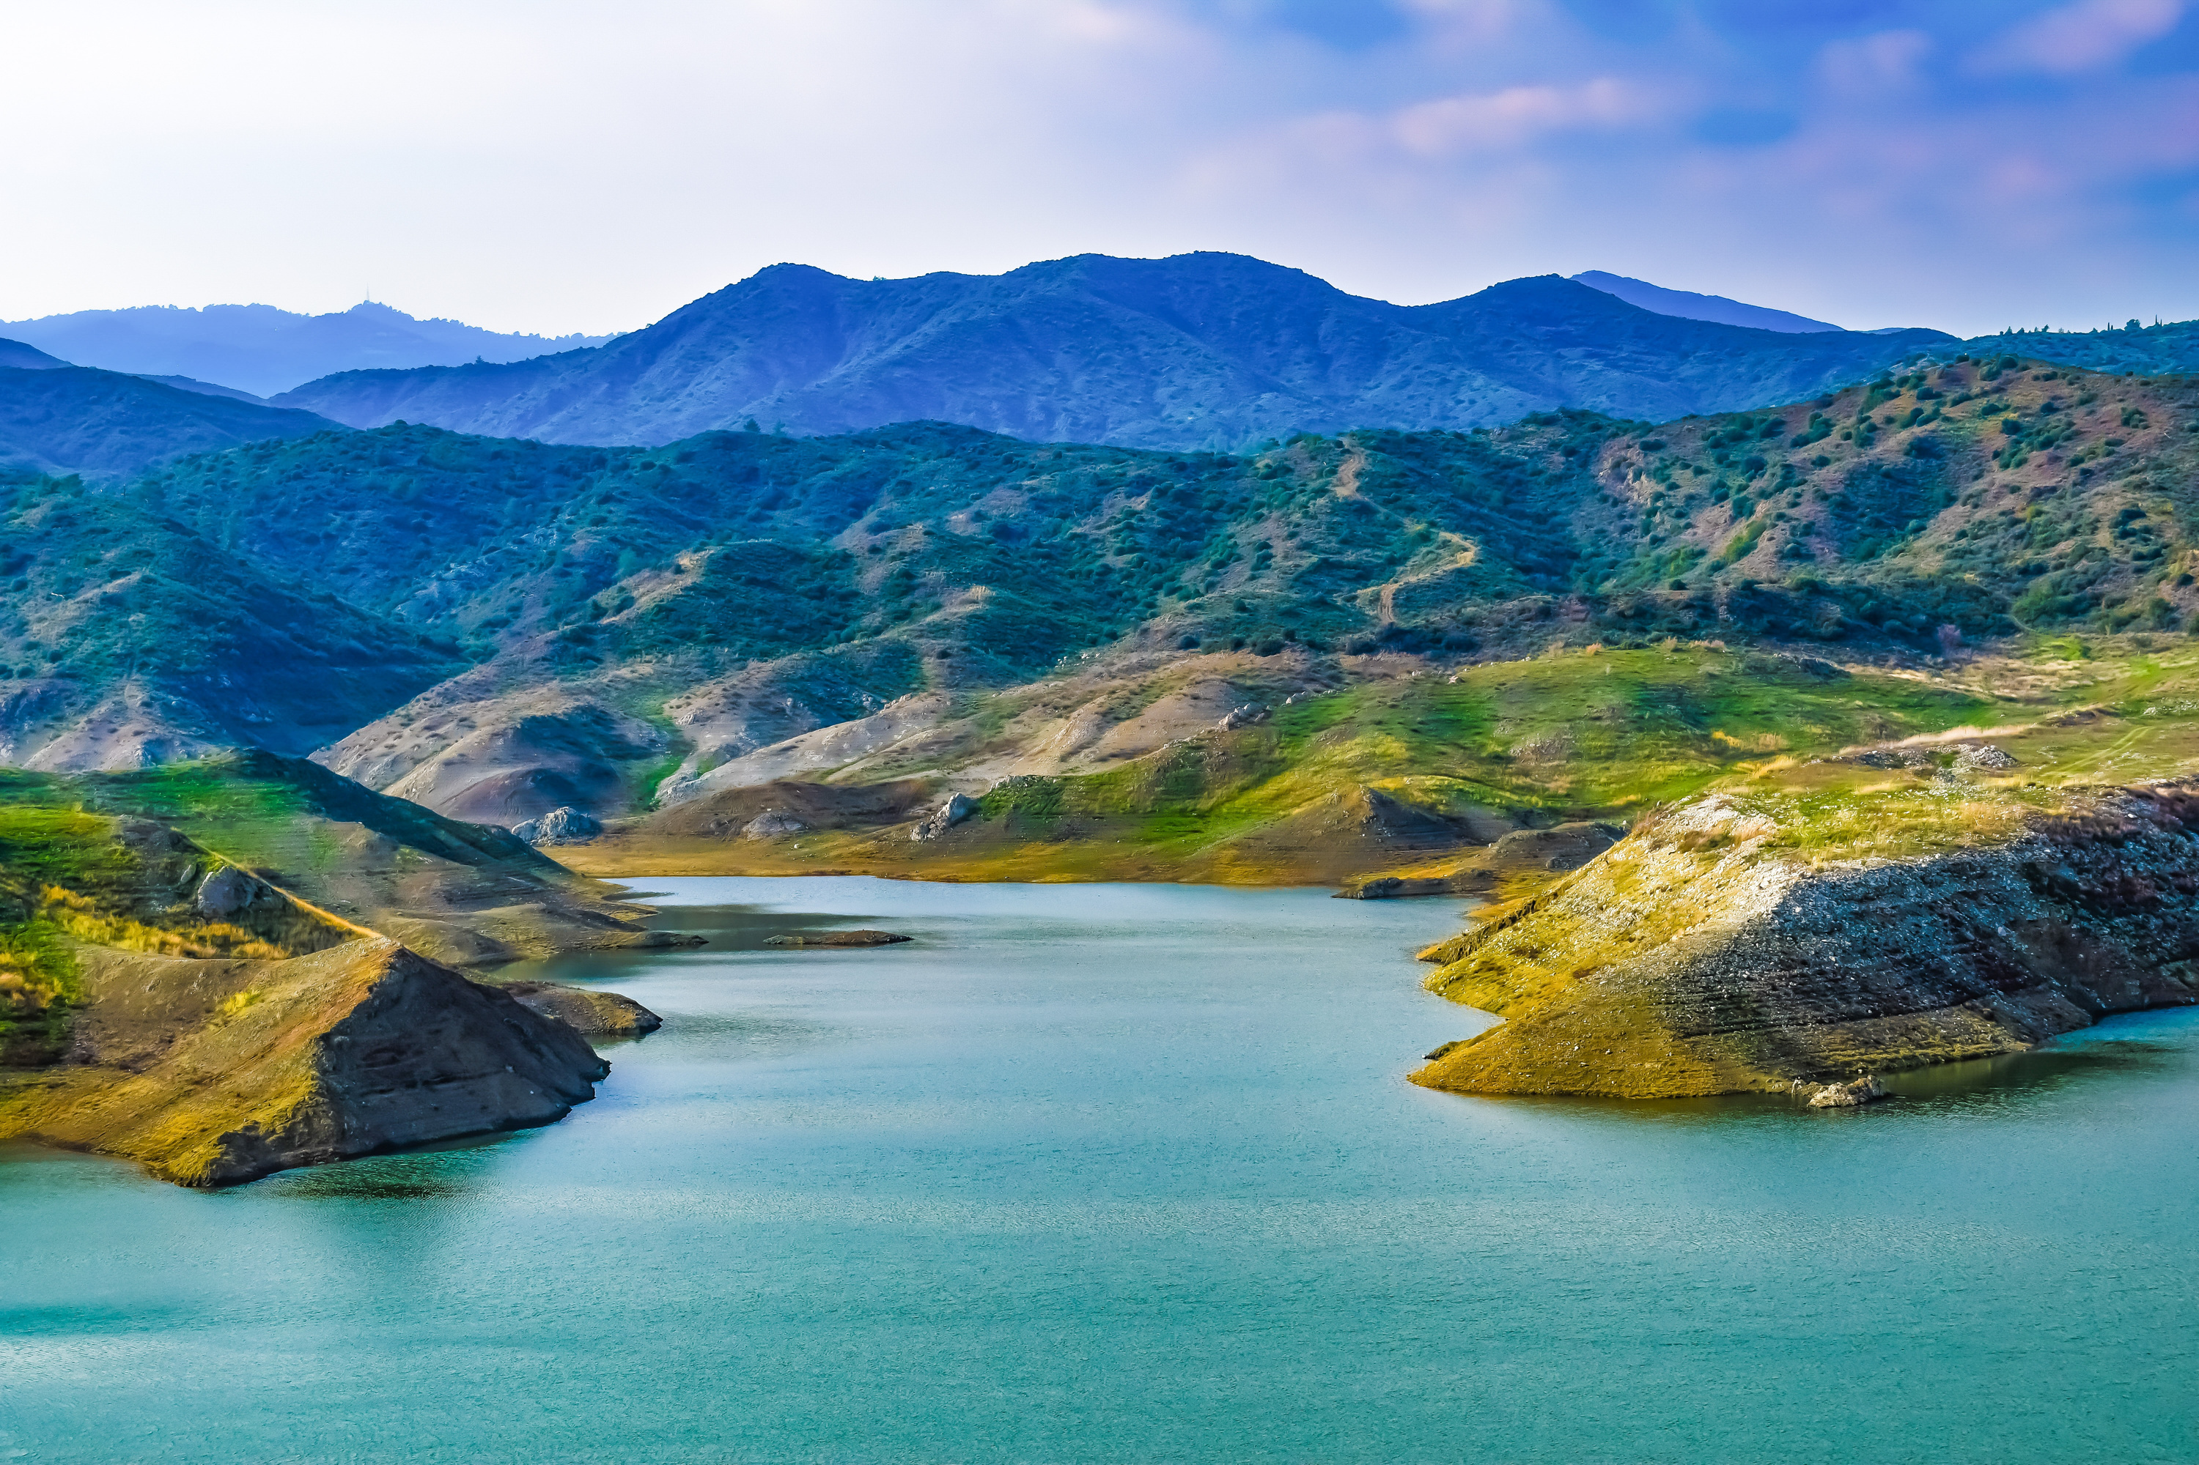
Travel Tips
When it comes to traveling, preparation is key. One of the best ways to prepare is by packing light. Not only will this save you from lugging around heavy bags, but it will also make it easier to navigate through crowded airports and cities. Make a list of essentials and stick to it, leaving behind anything that isn't necessary.
Another important tip is to stay hydrated. Traveling can be exhausting, especially if you're flying or spending long hours on a train or bus. Be sure to drink plenty of water and avoid sugary or alcoholic beverages, which can dehydrate you even more. And don't forget to bring a reusable water bottle to fill up along the way!

Slide 6
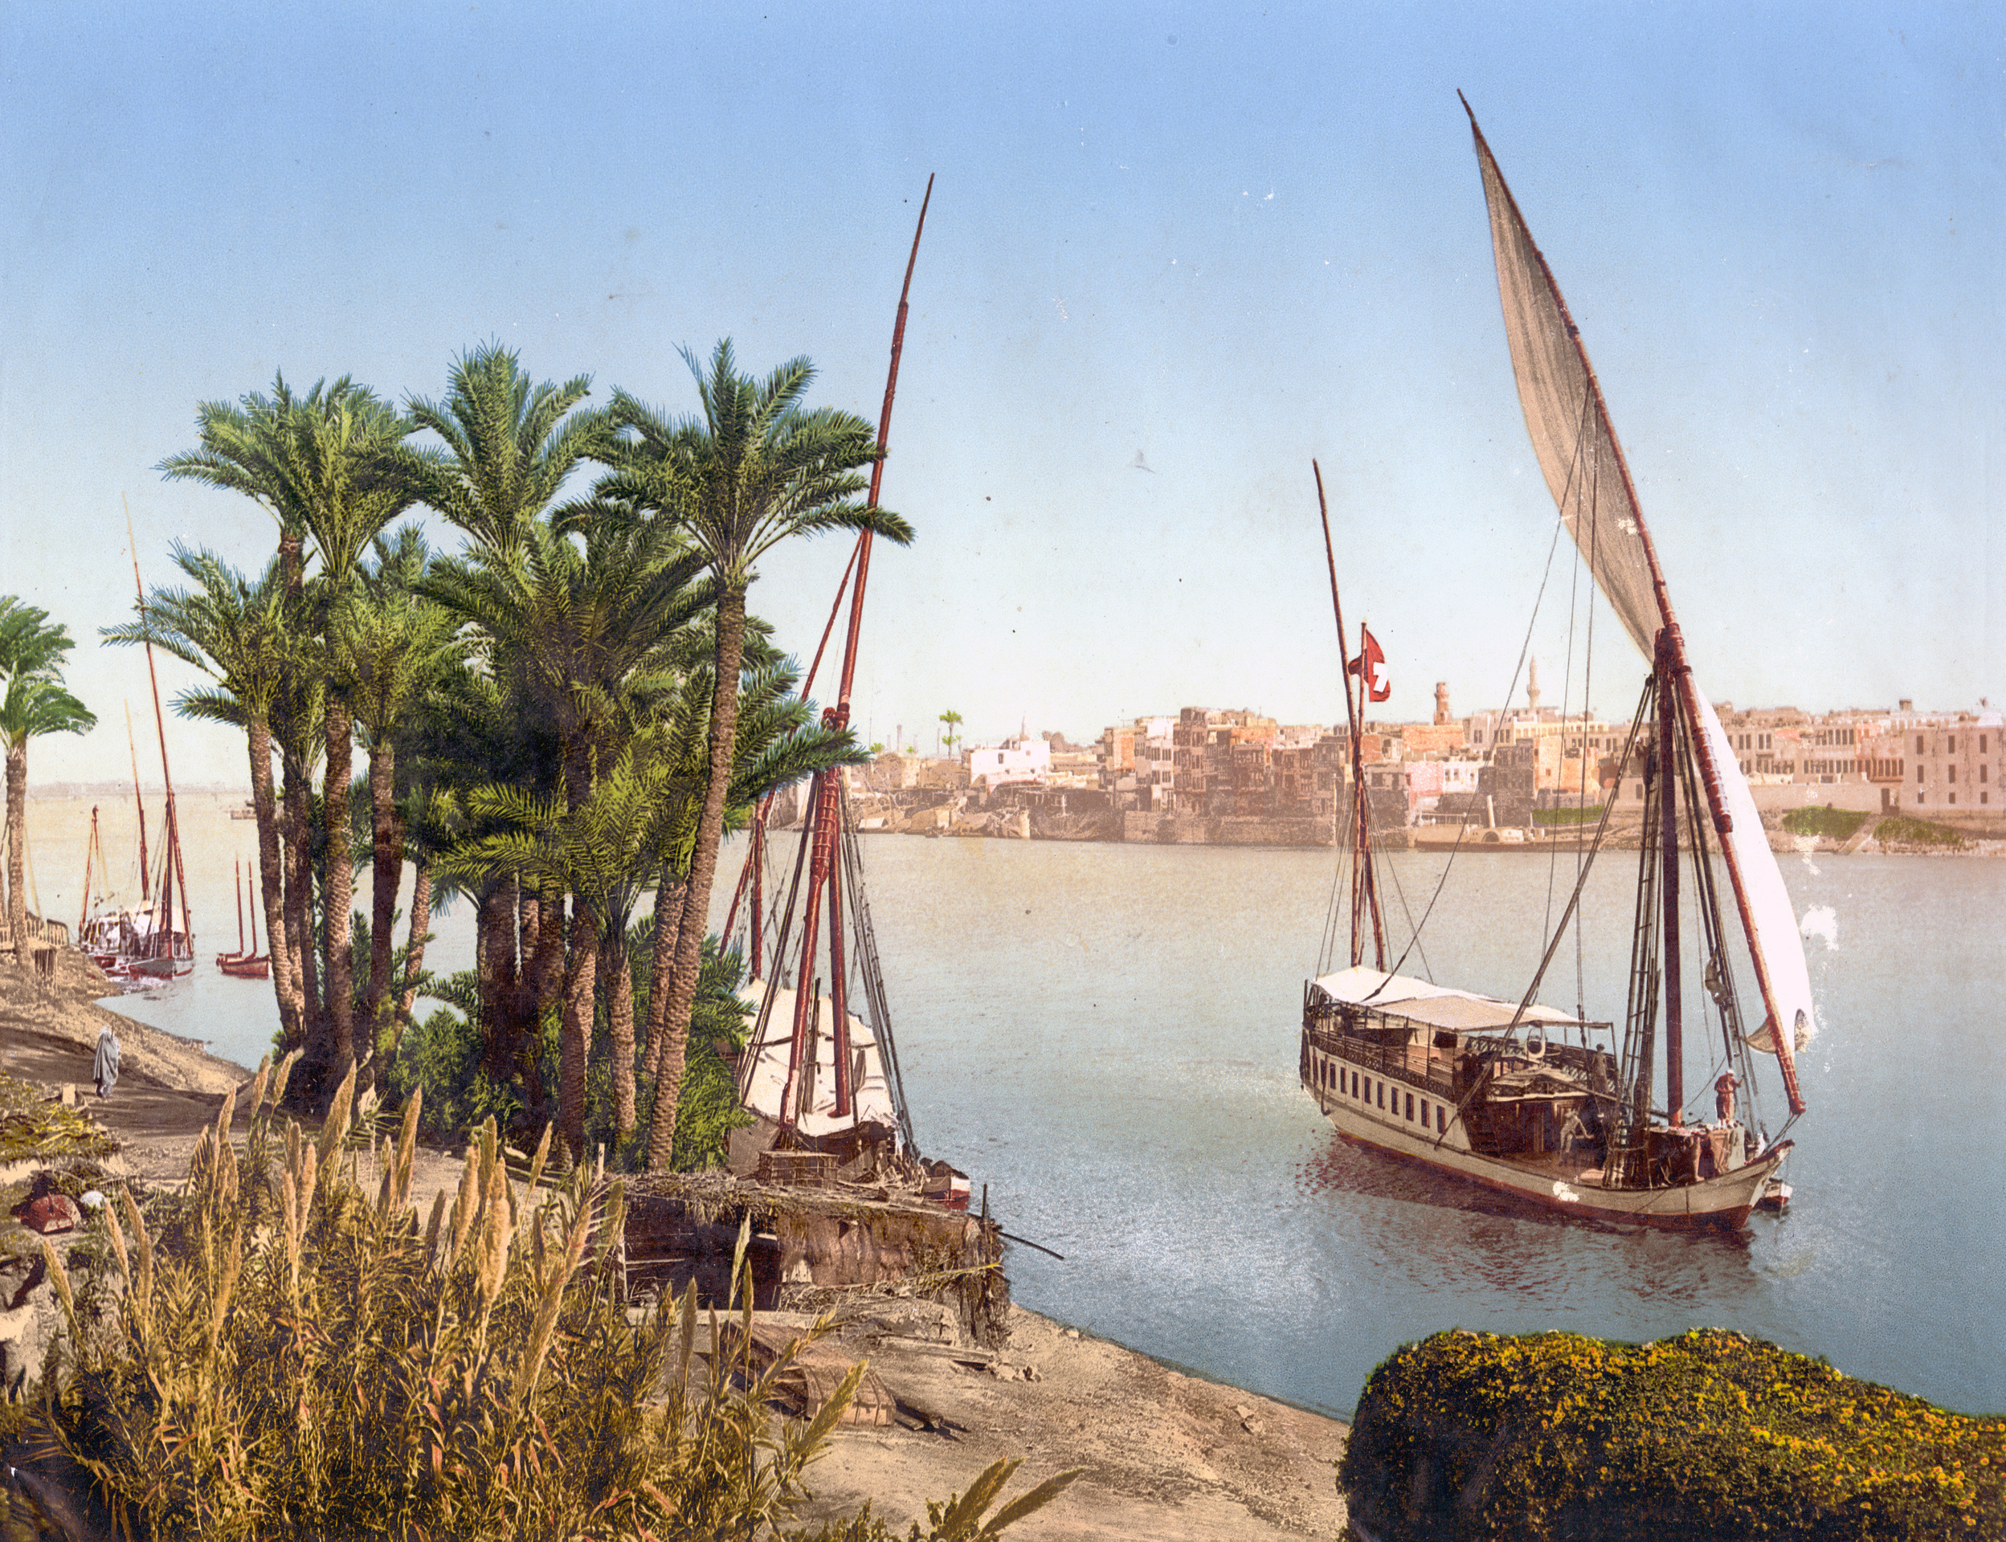
Overview
The touring and travel platform will be built using ReactJS, a popular JavaScript library for building user interfaces. ReactJS will enable the development of a seamless and intuitive user experience, with fast and responsive page loading times.
Features
Customizable search filters for finding tours and travel packages based on specific criteria, such as location, budget, and activities.
Interactive maps for exploring destinations and visualizing travel itineraries.
Secure payment processing for booking tours and travel packages.
Technical Implementation
ReactJS will be used for the front-end development of the platform, with a focus on creating reusable components for efficient and scalable code.
Backend services will be developed using Node.js and Express.js for handling server-side logic and API integrations

Slide 7
Thank you!

